Slide 1
ASSIGNMENT
Task 1: Use Venn diagram to test the validity of the THREE given arguments.
Task 2: Write TWO arguments about the given topics, then use Venn diagram to test the validity of your written arguments.
Link to submit:
https://forms.gle/hWeMGy3mSXGijeTz8

Slide 2
Names of your group
1. Nguyễn Ngọc Mỹ Phương -BEBEIU22114
2. Phạm Thái Nhật Thanh-BEBEIU22133
3. Nguyễn Thị Như Quỳnh-BEBEIU22122
4. Đặng Thị Trúc Thắm - BEBEIU22132
5. Đặng Trần Minh Châu - BEBEIU22019
6. Nguyễn Ngọc Phương Thảo - BEBEIU22135
7. Lê Đức Toản - EEEEIU22065
8. Đỗ Minh Duy - ITITSB22029

Slide 3
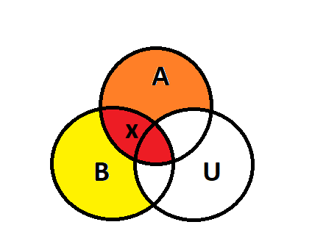
Question 1
If every student studies on the main campus, he/she is not taking the online lesson now.
A number of students are taking the online lesson now.
So, not all students study on the main campus.
Standardized argument: Premise 1: If every student studies on the main campus, he/she is not taking the online lesson now.
Premise 2: A number of students are taking the online lesson now.
Set A represents students studying on the main campus.
Set B represents students taking online lessons.
The universal set U represents all students.
Venn diagram
Symbolic argument:
All A is U
All B is U
B is not A
Conclusion: Valid

Slide 4
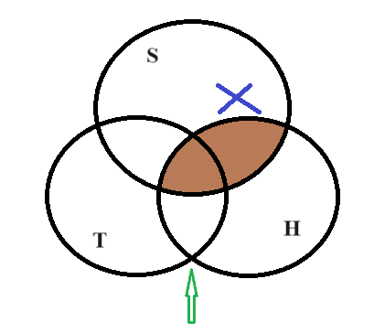

Question 2
A few students who want easy quizzes do not want to think deeply.
Not a student who wants easy quizzes can score high.
So, each student who wants to think deeply can get high scores.
Standardized argument:
Some students who want easy quizzes are not deep thinker.
No a student who wants easy quizzes are get high score.
So each student are deep thinker of getting high score
Venn diagram
Symbolic argument:
Some S are not T
No S are H
So some T are H.
Conclusion:
Notes:
No easy quiz wishers are

Slide 5
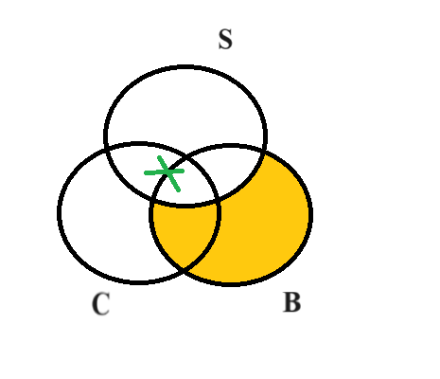

Question 3
Most clubs you attend can build your soft skills. If you build your soft skills now, you will definitely become efficient professionals later. So many club attendants can be more effective at work later.
Standardized argument:
Some clubs you attend (C) can build your soft skills. (S)
All soft skills builder are definitely become efficient professional later.
So some clubs can be more effective soft skills builder.
Venn diagram
Symbolic argument:
Some C are S
All B are S
So some C are B.
Conclusion:

Slide 6
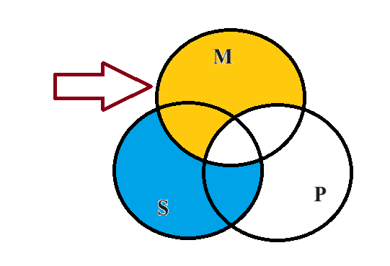
Question 4
Create a categorical syllogism: 1) with both premises in the stylistic forms and the conclusion in the standard form, and 2) about the topic of Quiz 1 questions/your result. Then check its validity using Venn diagram.
Stylistic argument: deductive argument
Standardized argument:
Premise 1: All correctly answer on Quiz 1(M) will receive a perfect score (P). Premise 2: All your answers(S) are correct answer on Quiz 1(M).
Conclusion: So, all your answers(S) are received a perfect score(P).
Symbolic argument:
-All M are P
-All S are M
- So, all S are P
Venn diagram
Conclusion: Valid

Slide 7
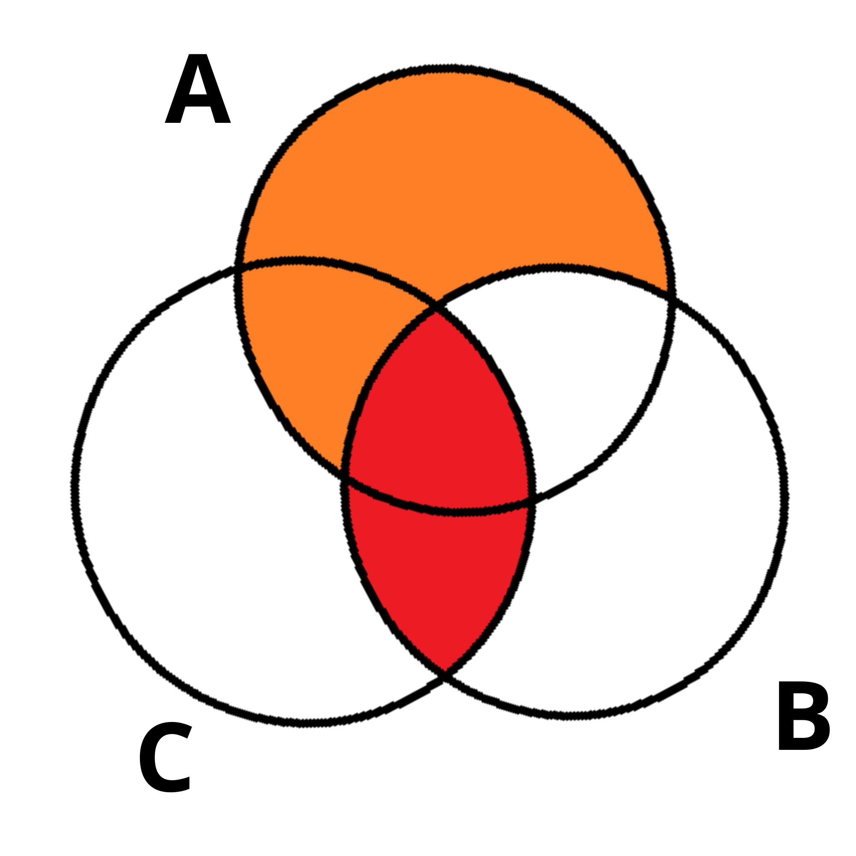
Question 5
Create a categorical syllogism 1) with the premises containing All & Some and the conclusion containing No, 2) all three statements must be the stylistic variants, and 3) about the topic of gains/losses of a semester with more than 20 credits. Then standardize it and check its validity using Venn diagram.
Stylistic argument: inductive argument
Standardized argument:
All semesters (A) with more than 20 credits result in significant academic gains.(B)
Some semesters(A) with more than 20 credits result in financial losses(C).
So, no significant academic gains (B) are in financial loses(C).
Venn diagram
Symbolic argument:
All A are B
Some A are C
So, No B are C
Conclusion: Invalid

Slide 8
THANK YOU

